Slide 1
Intro to Kafka
Ankush

Slide 2
Index
What is kafka
Basic components
Avro and Schema Registry
Kafka Connect
Kafka Streams
What questions to ask?

Slide 3
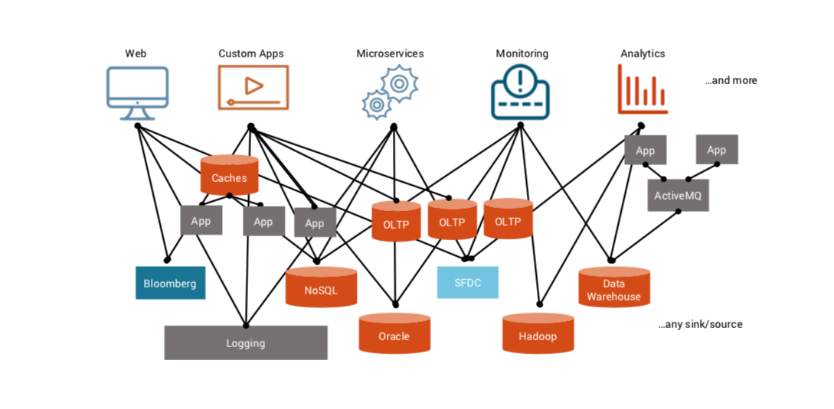
Architecture w/o kafka?
source: https://www.slideshare.net/PaoloCastagna1/introduction-to-apache-kafka-confluent-and-why-they-matter

Slide 4
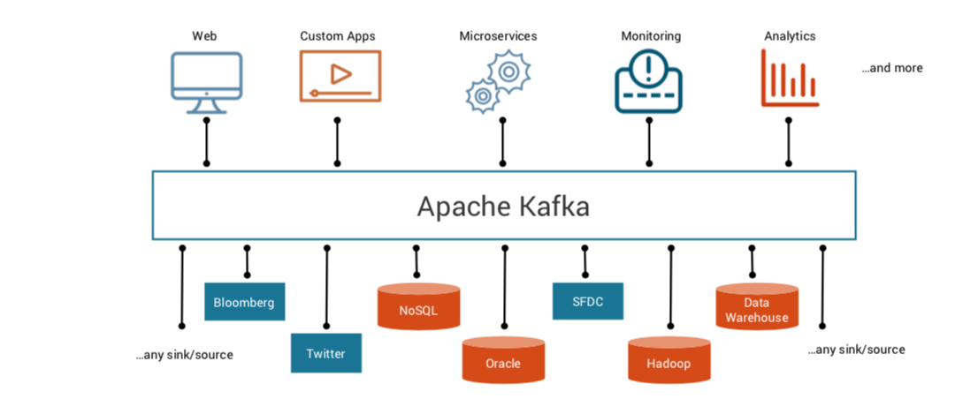
Architecture with Kafka?
source: https://www.slideshare.net/PaoloCastagna1/introduction-to-apache-kafka-confluent-and-why-they-matter

Slide 5
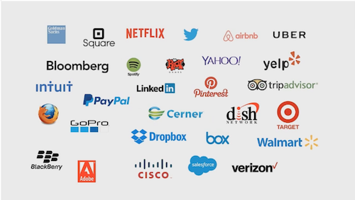


Kafka everywhere

Slide 6
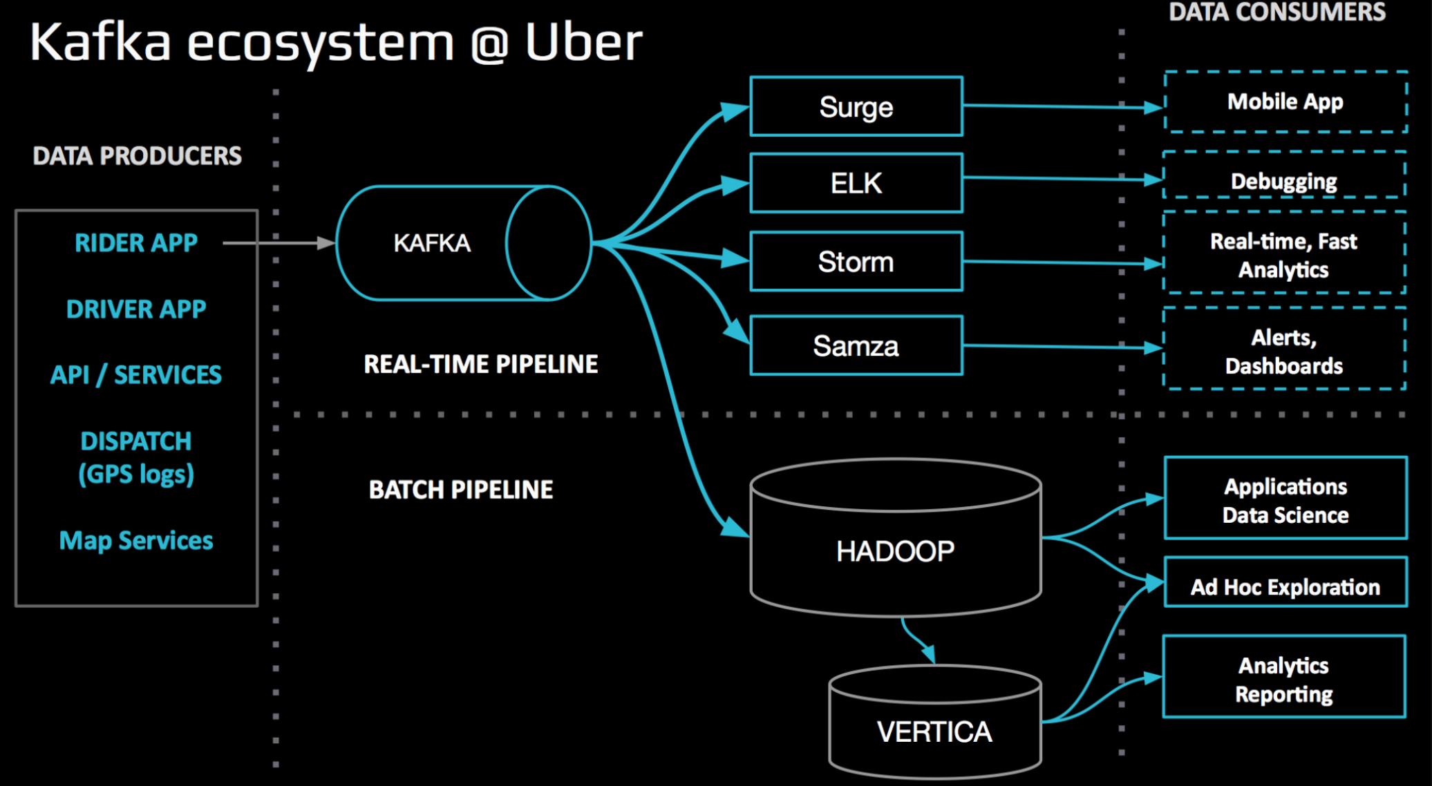
Kafka everywhere

Slide 7
Basic terms

Slide 8
Messages in kafka
Kafka Message
Key
Value
Timestamp

Slide 9
Topic in Kafka
Producer pushes messages to a topic
Consumer consumes messages from a topic

Slide 10
Kafka Broker
Kafka broker => Physical machine on which Kafka is running
Kafka Cluster => Multiple Kafka brokers => Multiple machines working together

Slide 11
Logs
Data segments present in your disk
Stores messages in a order fashion
Assigns sequence id to each message before storing in logs

Slide 12
Partitioning in Kafka
Scalability

Slide 13
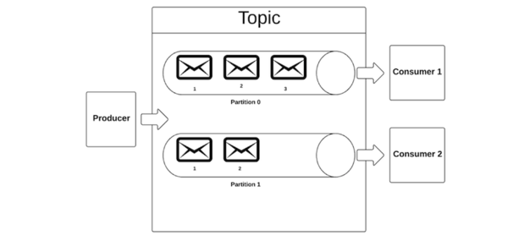
Topics and Partitions in Apache Kafka
topic partitions are a unit of parallelism
a partition can only be worked on by one consumer in a consumer group at a time

Slide 14
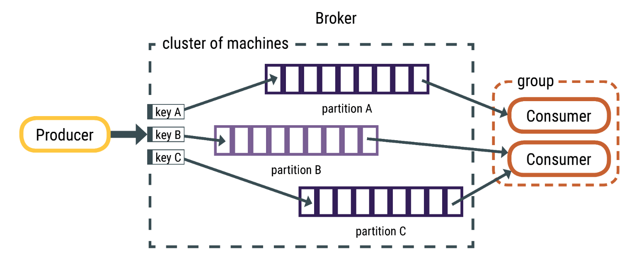
Partitions in Apache Kafka

Slide 15
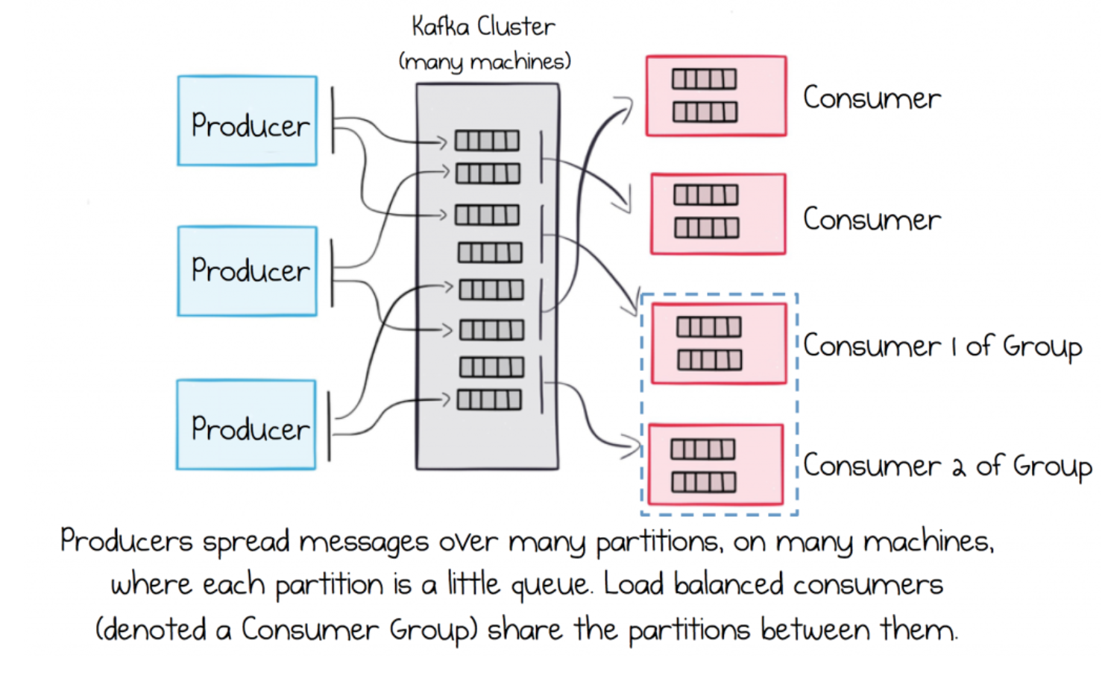
Partitions in Apache Kafka

Slide 16
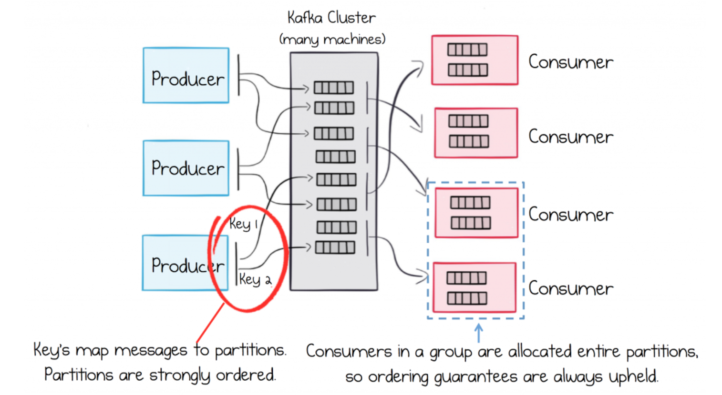
Partitions in Apache Kafka

Slide 17
Replication in Kafka
Fault tolerance

Slide 18
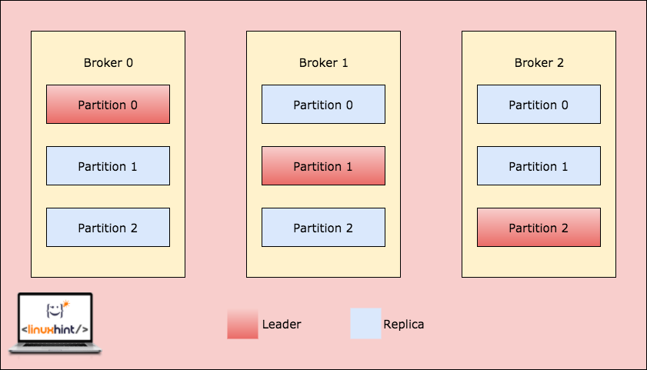

Slide 19
Configuration terms

Slide 20
Configurations Topic
retention.ms => Amount of time logs will stay before they get deleted
cleanup.policy=[delete|compact], either delete the messages from topic or compact them
partition, scalability count
replication, number of times a partition will be replicated

Slide 21
Configuration Consumer
offset => What has already been read by the consumer
consumer.group.id => Identifier for the consumer group
auto.offset.reset=[earliest|latest], when consumer connects for first time to a topic (offset does not exists for this consumer.group.id), where to start reading from. From first (earliest) message or last (latest) message

Slide 22
Configuration Producer
acks: [0|1|all]
0 => Does not wait for leader or replica broker to write the message to disk
1 => Waits for leader broker to write the message to disk
all => Waits for leader and all replica to write the message to disk

Slide 23
Kafka Scaling

Slide 24
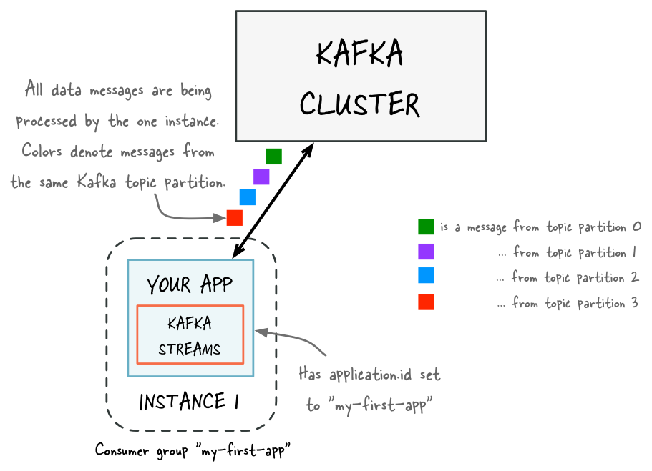
Kafka Scaling

Slide 25
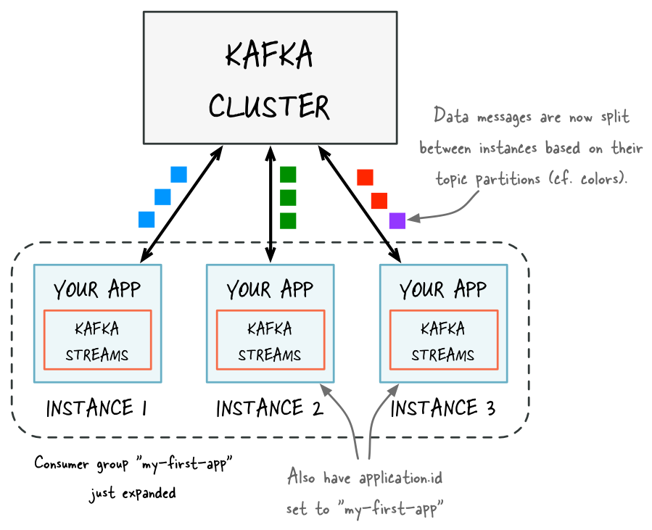
Kafka Scaling

Slide 26
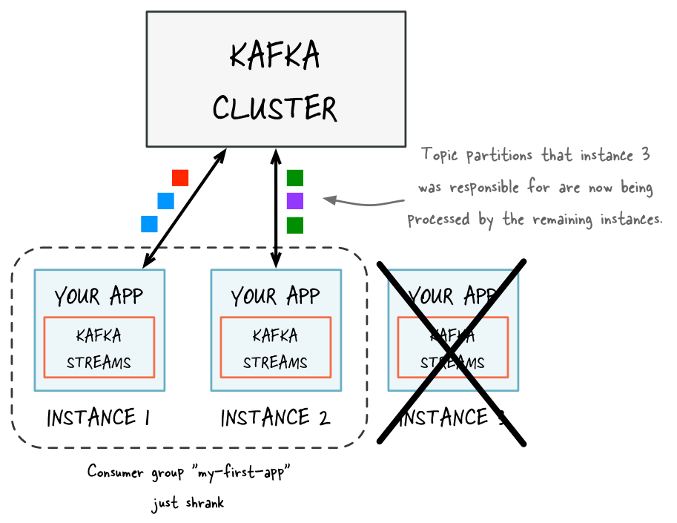
Kafka Scaling

Slide 27
Avro & Schema Registry

Slide 28

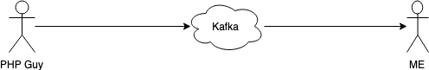
Why is schema needed?
PHP Object

Slide 29
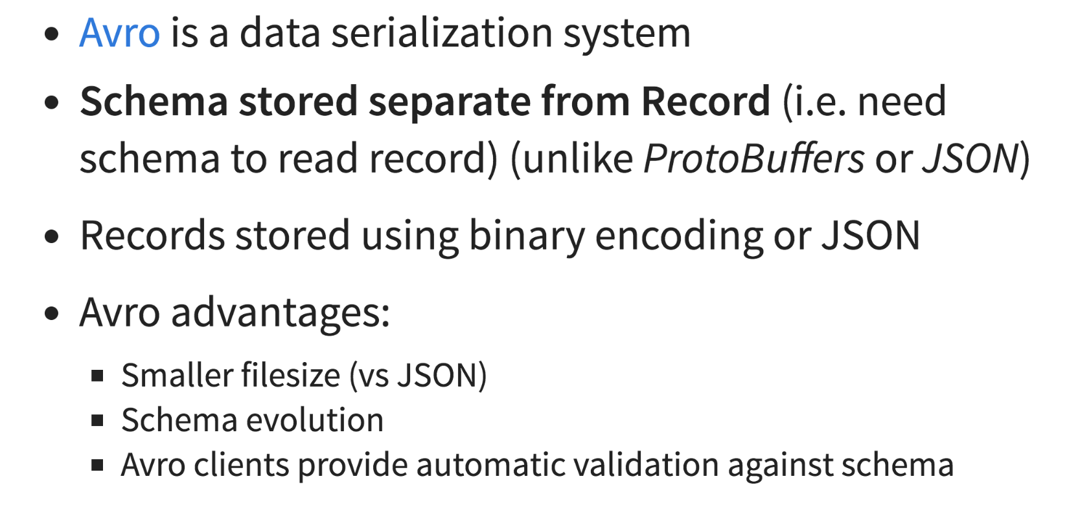
What is Avro

Slide 30
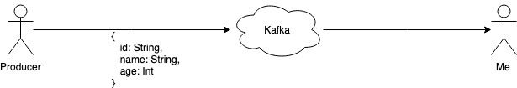
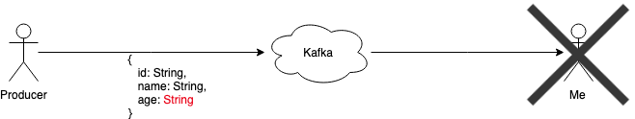
Why Schema Compatibility?

Slide 31
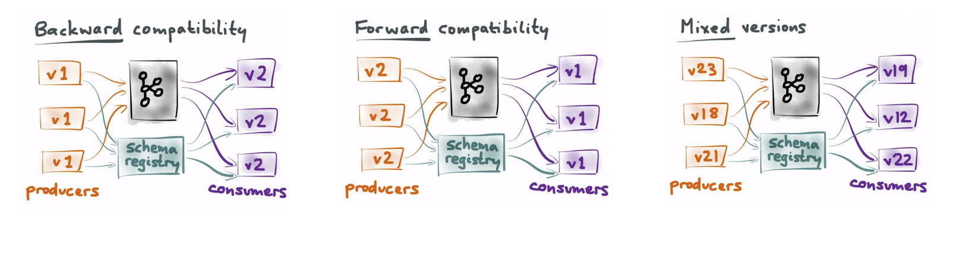
Avro schema evolution

Slide 32
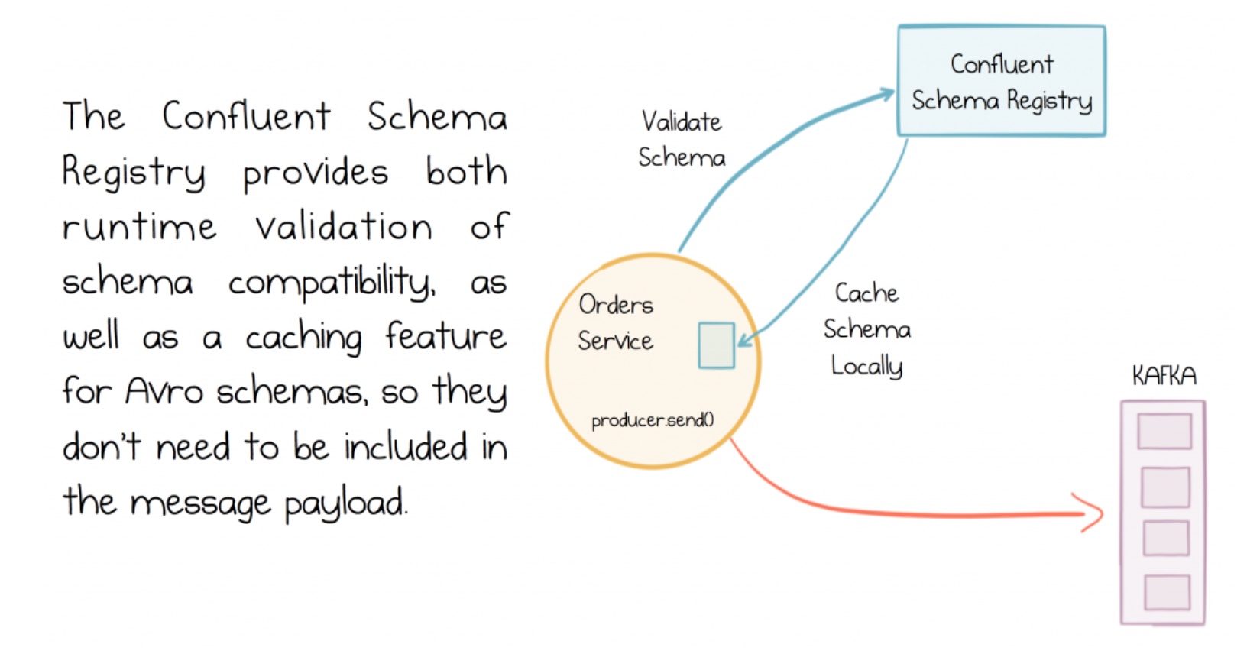
Schema Registry

Slide 33
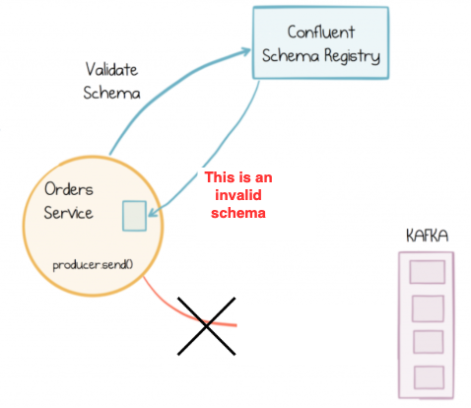
Schema Registry

Slide 34
Kafka Connect

Slide 35
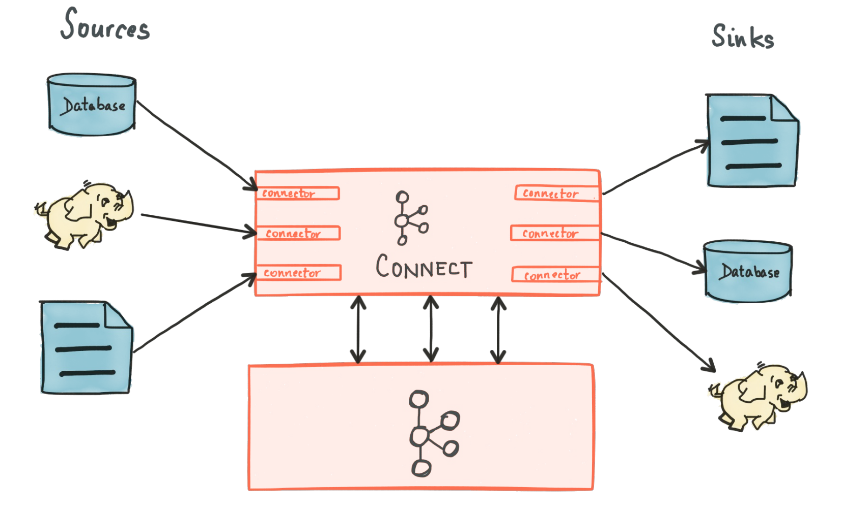
Sources and Sinks - Connectors

Slide 36
Available - Kafka Connect
https://www.confluent.io/hub/
Alternatives:
Alpakka
Custom Kafka Connect
...

Slide 37
curl -X POST http://localhost:8083/connectors -H "Content-Type: application/json" -d '
{
"name": "google_history_trip_connector",
"config": {
"connector.class": "io.confluent.connect.jdbc.JdbcSinkConnector",
"tasks.max": "1",
"topics": "google_history_trip",
"connection.url": "jdbc:mysql://localhost/kafka_offload",
"auto.create": "true",
"connection.user": "root",
"connection.password": "*******",
"key.converter": "io.confluent.connect.avro.AvroConverter",
"value.converter":"io.confluent.connect.avro.AvroConverter",
"value.converter.schema.registry.url": "http://localhost:8081",
"key.converter.schema.registry.url": "http://localhost:8081",
"key.converter.schemas.enable":"true",
"value.converter.schemas.enable":"true",
….
}
}'

Slide 38
Kafka Stream

Slide 39
Kafka stream
Client library for building stream application
Data from Kafka to Kafka
Stream application
Fault tolerant
Scalable
Event processing with milliseconds latency
Provides a convenient DSL

Slide 40
Kafka stream
Kafka stream in short
Millisecond delay
Balance the processing load as new instances of your app are added or existing ones crash
Maintain local state for tables
Recover from failures

Slide 41
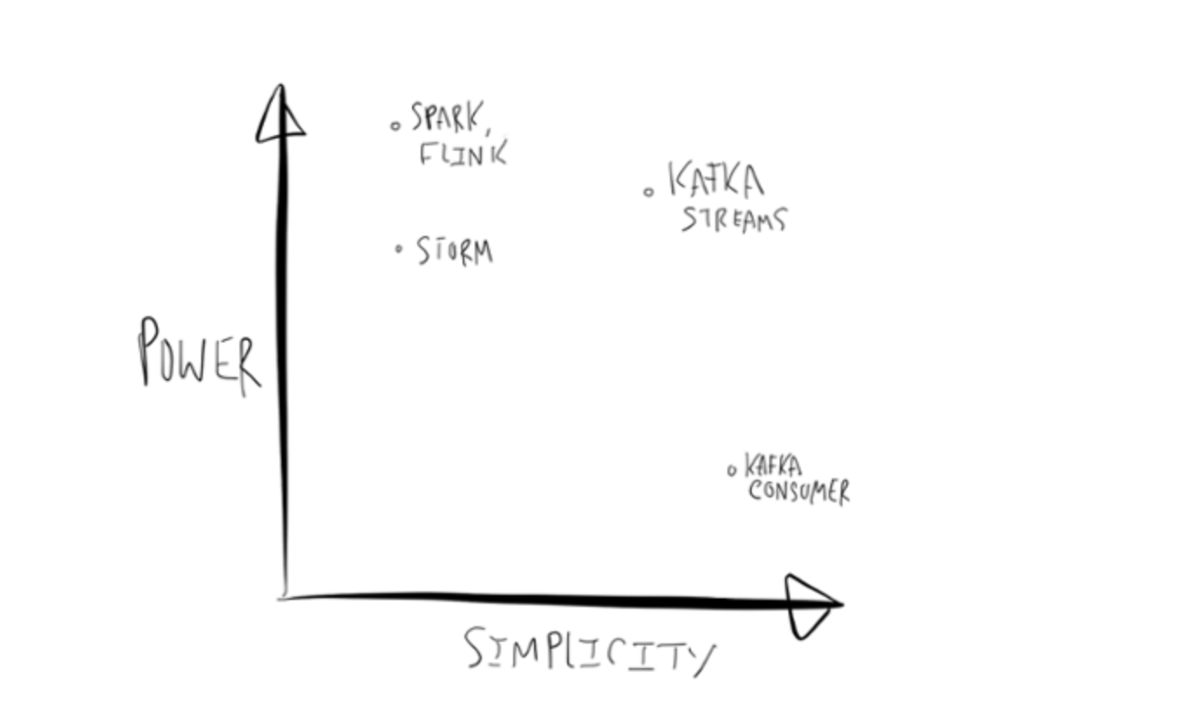

Slide 42
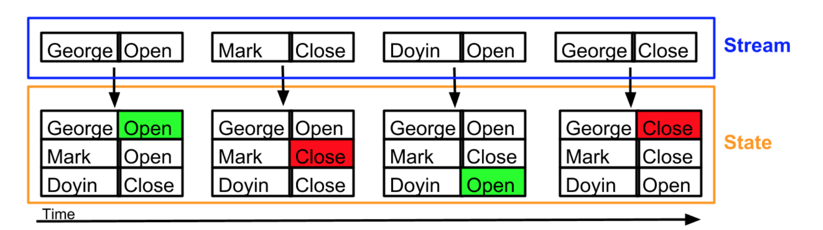
Kafka streams vs State

Slide 43
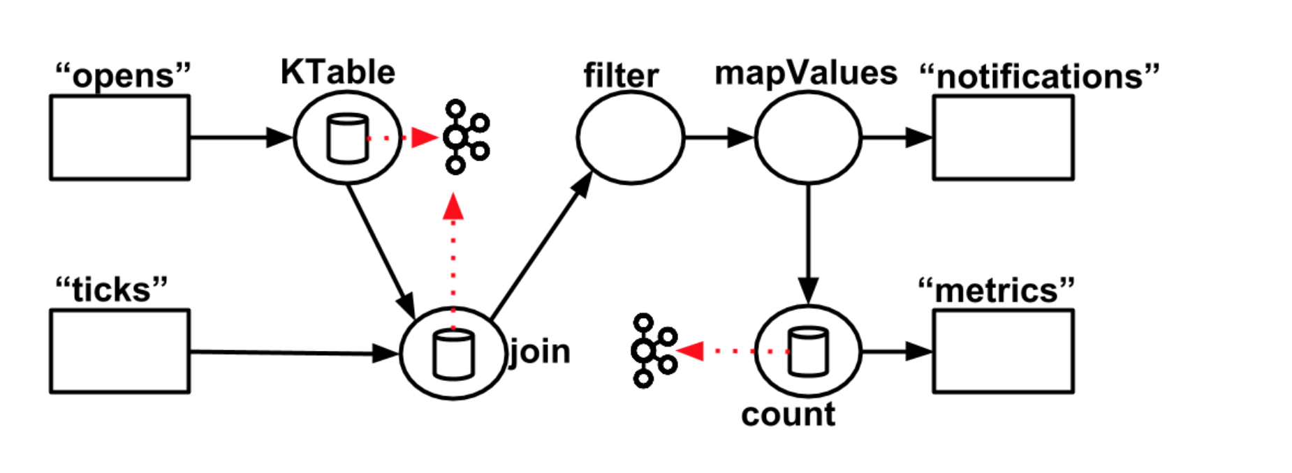
Kafka streams topology

Slide 44
Kafka stream features
Aggregates: count, groupby
Stateful processing (Stored internally in Kafka topic)
Joins
KStream with KStream
KStream with KTable
KTable with KTable
Windows
Time based
Session based

Slide 45
KSQL

Slide 46
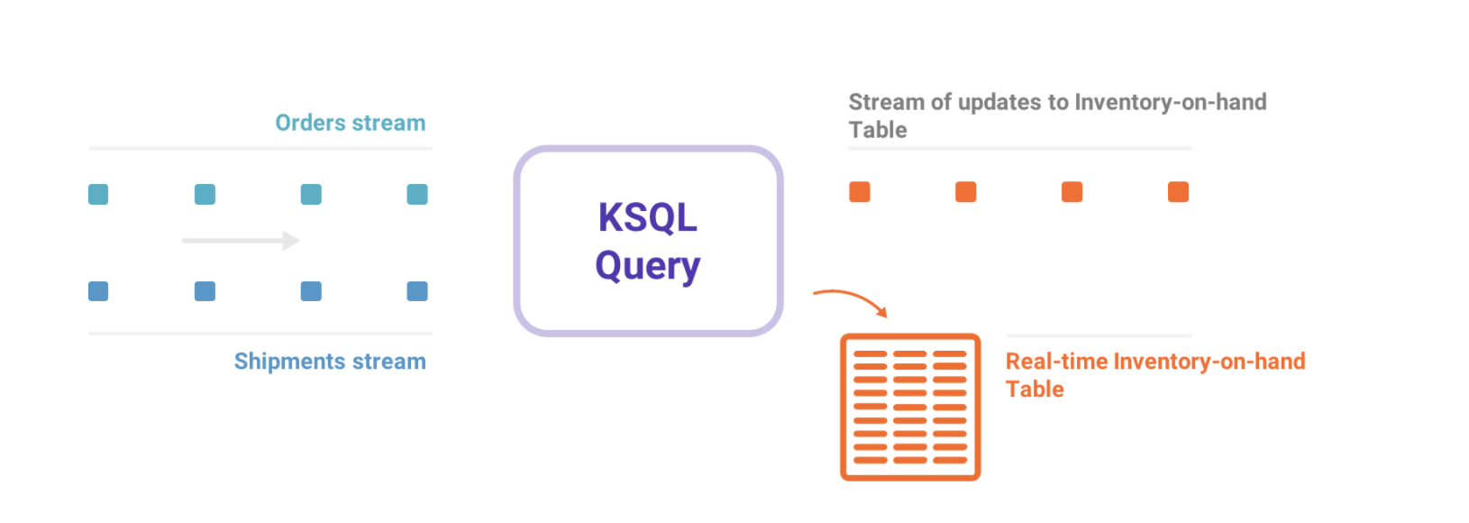

Slide 47
What questions to ask?

Slide 48
What questions to ask?
Replication factor?
>= 3, for Kafka Brokers (>=3)
Retention time?
<= 1 month, think wisely if you would like to have more
Partition size?
>=5 & <=20 (normal cases), depends on your size of incoming data, consumer throughput
Kafka can handle high partition size, but has extra cost
Is key needed?
Yes, same key to same partition
Prevent skew - if key is random enough
Scalability
Worst case: null, never a constant

Slide 49
What questions to ask?
Topic name structure?
tr-<TEAM_NAME>-<CONTENT>-<EXTENSION>
Consumer group-id?
tr-<TEAM_NAME>-<CONTENT>-<ACTION>-<EXTENSION>

Slide 50
Questions?

Slide 51
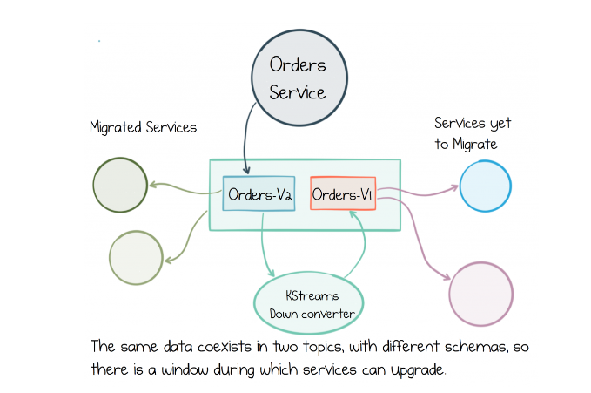
What if Schema cannot be compatible?

Slide 52
